Slide 1
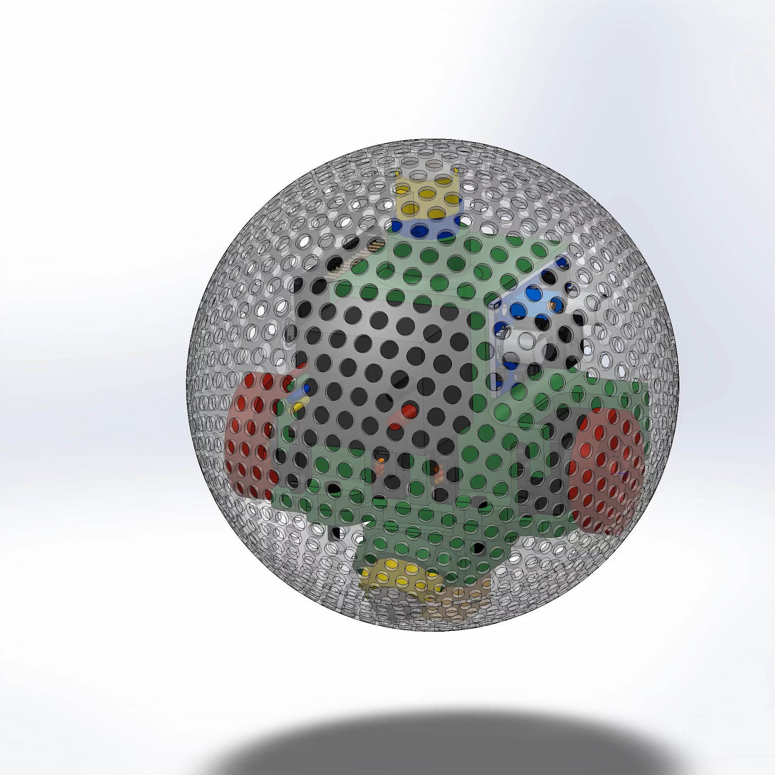
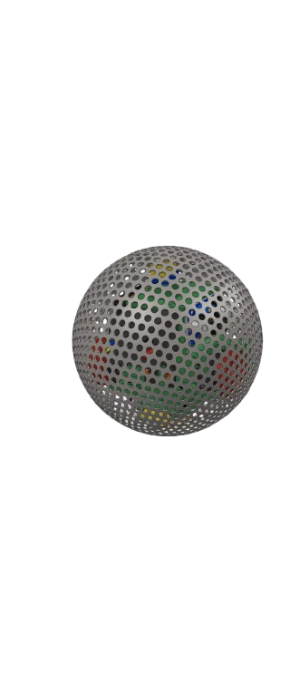
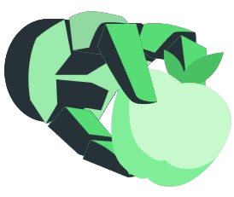


SPHERO BOT – MSRR
GRP MEMBERS :
Mohamed Nalim (398504)
Muhammad Waseem Irfan (394774)
Umair Akram (386627)
Saad Ahmad (398332)
SUPERVISORS :
Dr. Hamid Jabbar
Dr. Mohsin Islam Tiwana

Slide 2
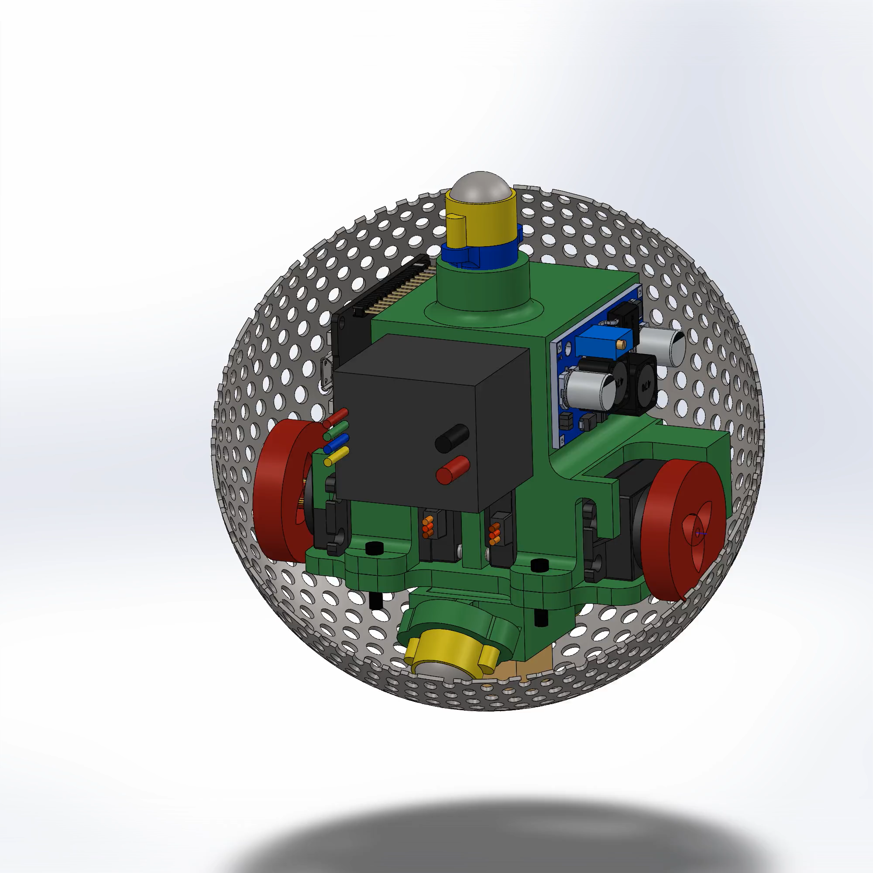
INTRODUCTION
Sphero BOT is a modular (inspired from Free bot), self-reconfigurable robot with a spherical ferromagnetic shell and an internal magnet, allowing seamless connections at any point
Moves using two motors, enabling omnidirectional motion and eliminating the need for dedicated connectors
Capabilities: ✅ Independent movement on a plane ✅ Climbs ferromagnetic walls ✅ Traverses complex terrain in groups ✅ Performs multi-tasking through modular coordination

Slide 3
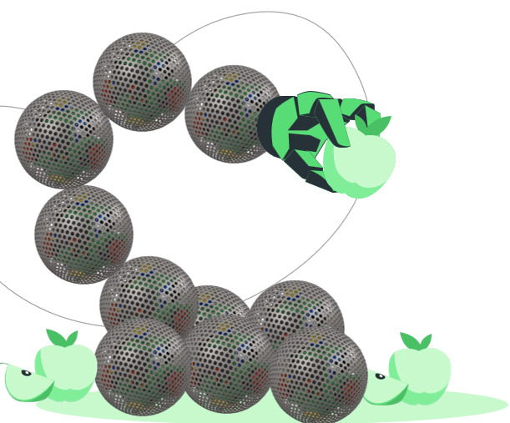

DELIVERABLES
Three Modular Units:
Can connect and rotate while attached.
Can move independently (locomotion, rotation, etc.)
1
2
Collaborative Communication:
Modules can communicate and coordinate to form specific configurations
3
Task-Specific Extension:
A gripper attachment enables pick-and-place operations
4
User Interface:
Configures the modular system
Displays real-time status of each module

Slide 4
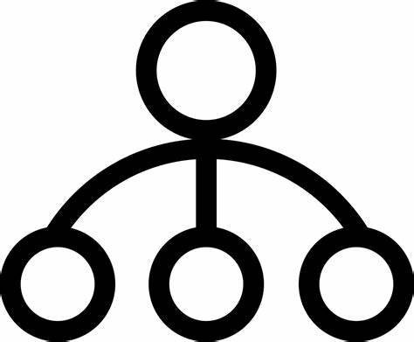
WORK DISTRIBUTION
Nalim
Waseem
Mechanical Design
Fabrication
Analysis
Communication
OTA
ROS
Umair
Saad
Servo Control
Localization
Algorithm
Electrical Design
Integration
User Interface

Slide 5
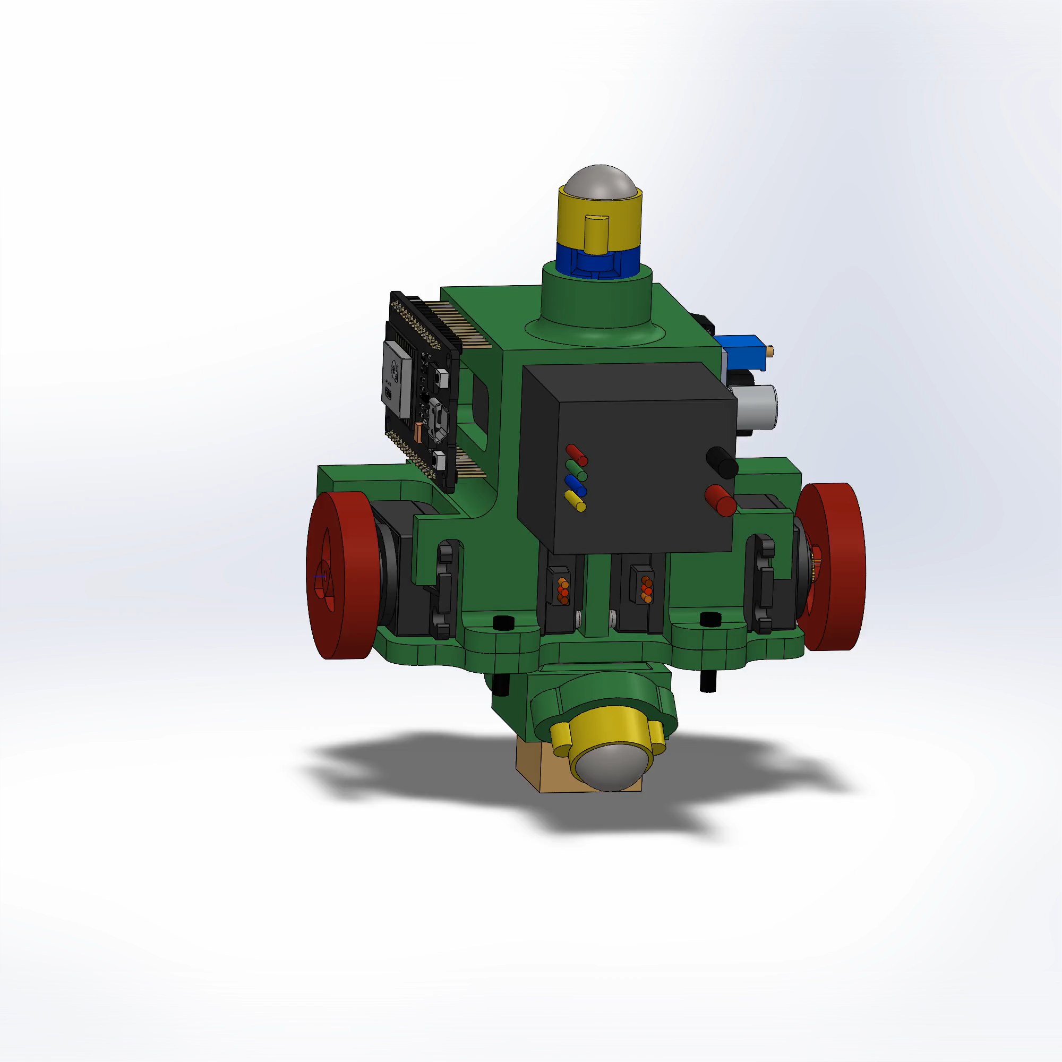
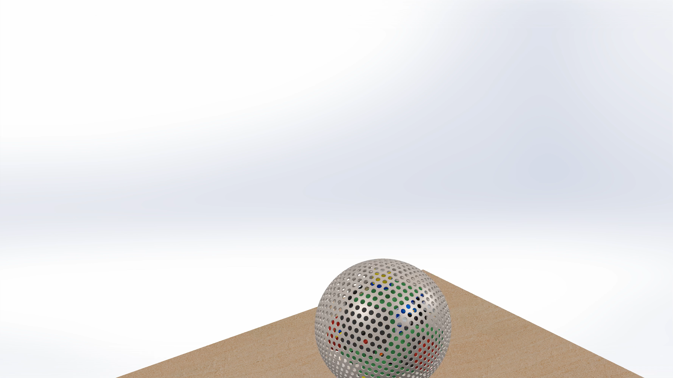

MECHANICAL DESIGN OVERVIEW
N20 Caster wheel
Spring
MS shell
M4 Srews
ESP 32
3D Printed Chassis
Rubber Wheel
3S Lippo Battery
MG996R Servo Motor
Buck Module
N42 Neodymium Magnet

Slide 6
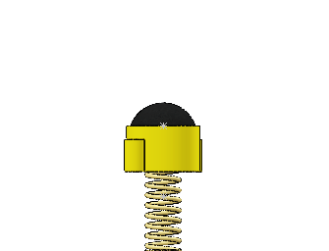
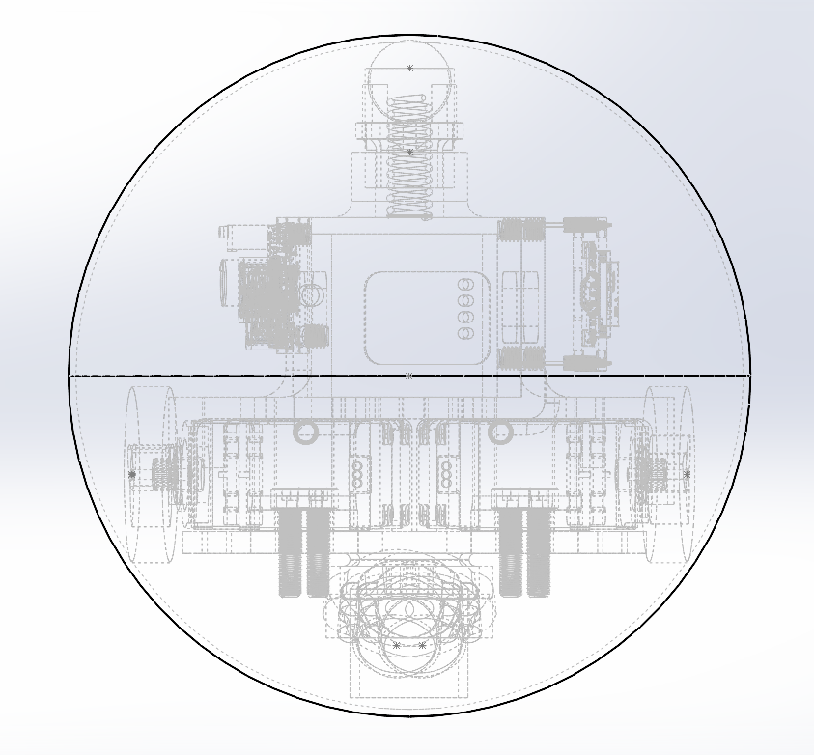
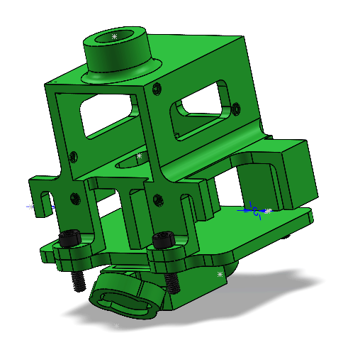

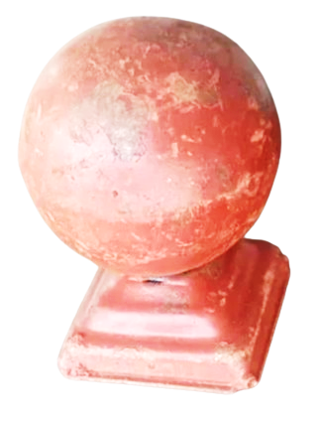
DESIGN & FABRICATION
Shell: Pre-made 5-inch diameter railing ball with holes to allow signal transmission
Chassis: 3D printed with ABS for strength and lightweight design
Wheel System:
Drive Wheels: Touch the shell for motion
Caster Wheel: Mounted with a spring for energy absorption and grip in small dents
Center of Mass: Positioned below the ball’s centre for smooth rolling

Slide 7
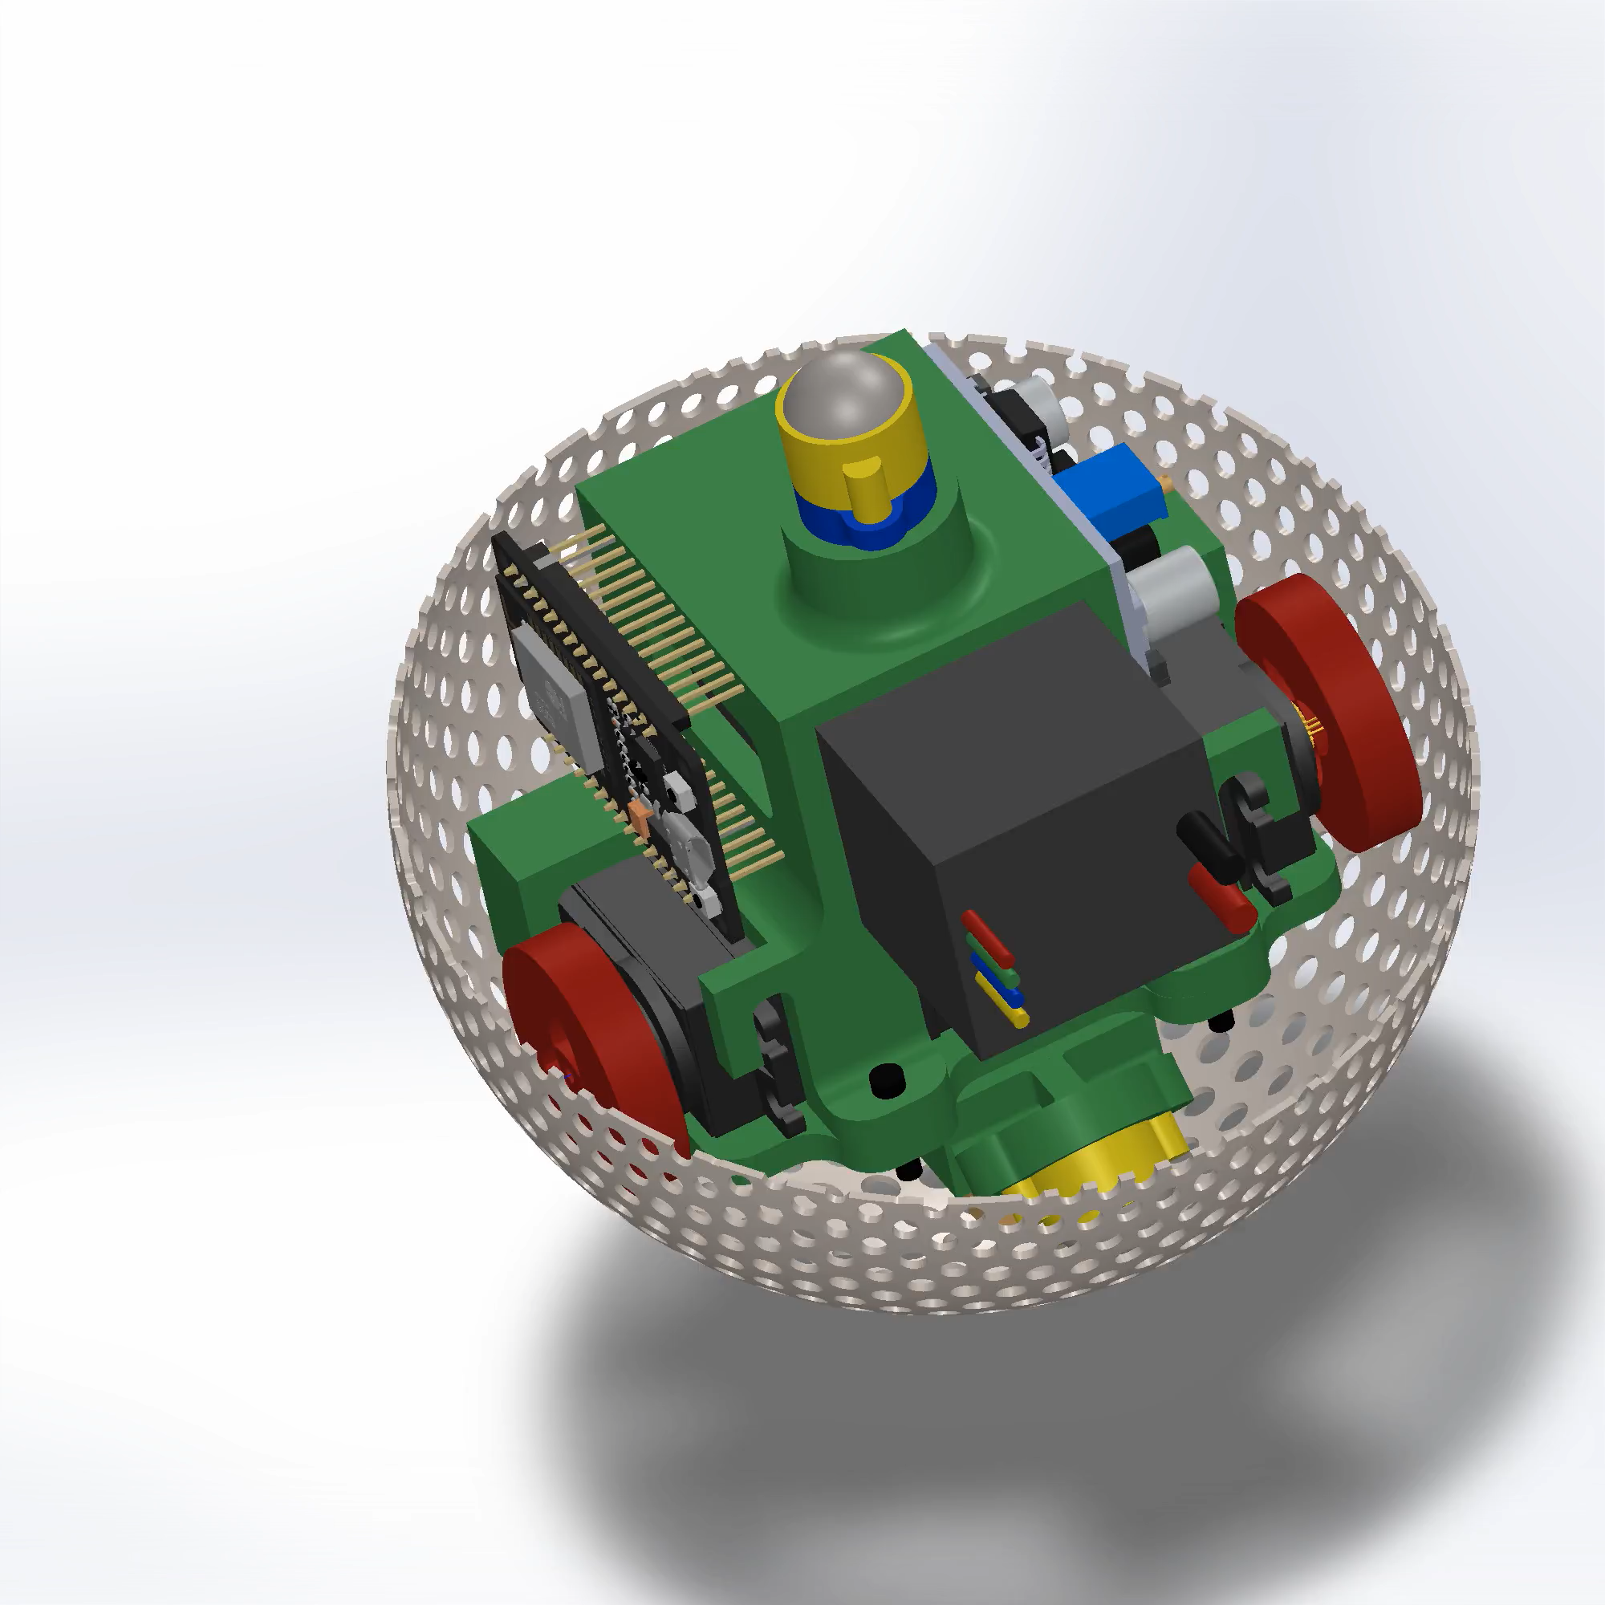
DESIGN CHALLENGES
Signal Transmission: Shell holes help bypass Faraday’s cage effect
Structural Adjustments: Enhancing chassis durability and weight distribution
Improved Grip: Optimizing caster wheel and spring tension
Point connection between modules (Line connection if holes)

Slide 8
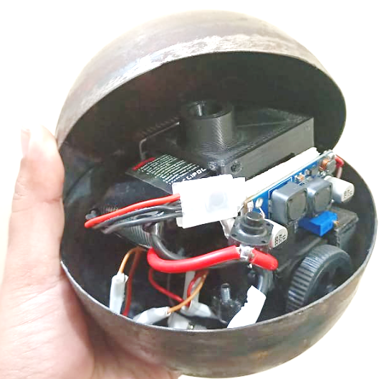
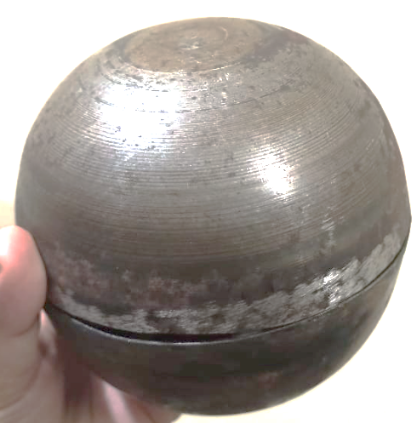
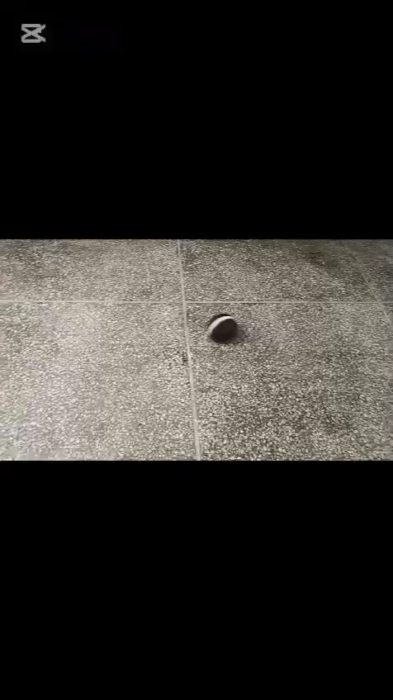
MOTION & STRUCTURAL STABILITY
Differential Drive System: Both wheels touching the shell enable controlled rolling
Magnetic Attachment: Strong enough to hold the bot while maintaining modularity
Compact Design: All components fit within a 5-inch ball while maintaining balance
Weight Optimization: ~600g for stable locomotion and connectivity

Slide 9
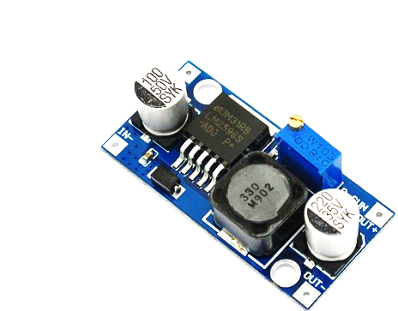
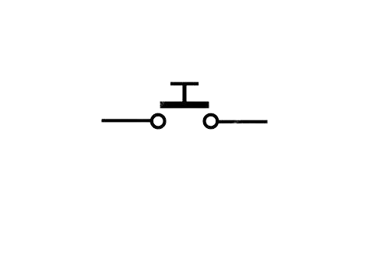
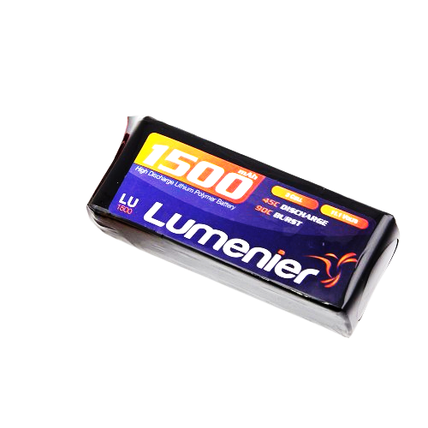

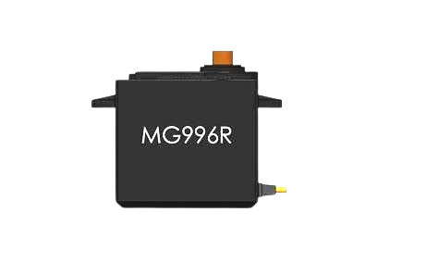
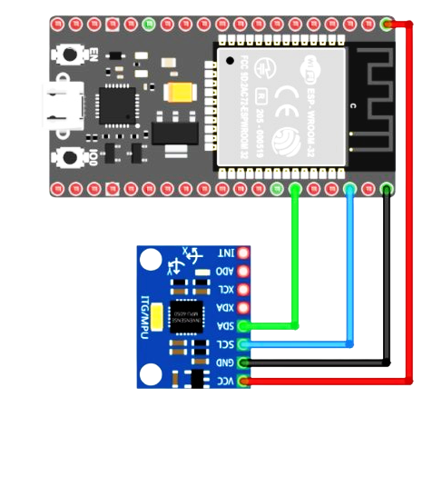
ELECTRICAL DESIGN
VCC
GND
SIG

Slide 10

SYSTEM INTEGRATION
Bringing Mechanical, Electrical, and Software Together
Hardware:
ESP32 as microcontroller with Wifi/Bluetooth functionality
Magnetic connectors for modularity
Software:
Centralized control for coordinated movement
OTA updates for remote firmware upgrades
Challenges:
Synchronizing hardware & software
Ensuring real-time localization
Managing power efficiency

Slide 11
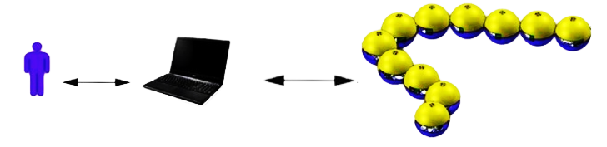
USER INTERFACE
Live Bot Tracking:
Real-time position & connection status
Control Panel:
Move bots, form shapes for applications
Challenges:
Intuitive UI, real-time visualization, efficient data transmission

Slide 12
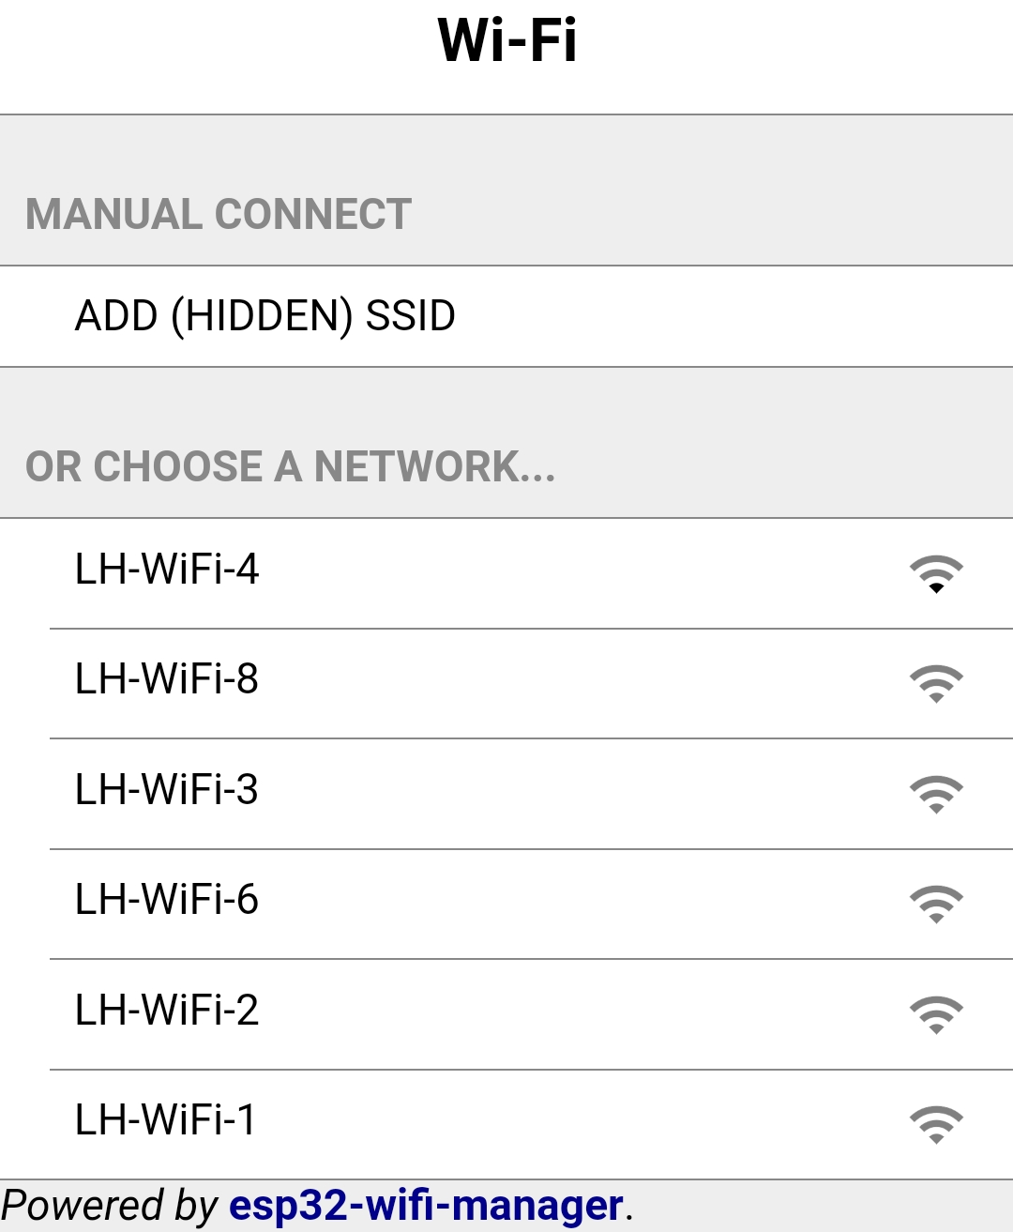
ESP32-WIFI-MANAGER
Wifi-Manager is a pure C esp-idf component for ESP32 that enables easy management of wifi networks through a web portal
It will automatically attempt to re-connect to a previously saved network
If it cannot find a saved wifi it will start its own access point through which you can manage and connect to wifi networks

Slide 13
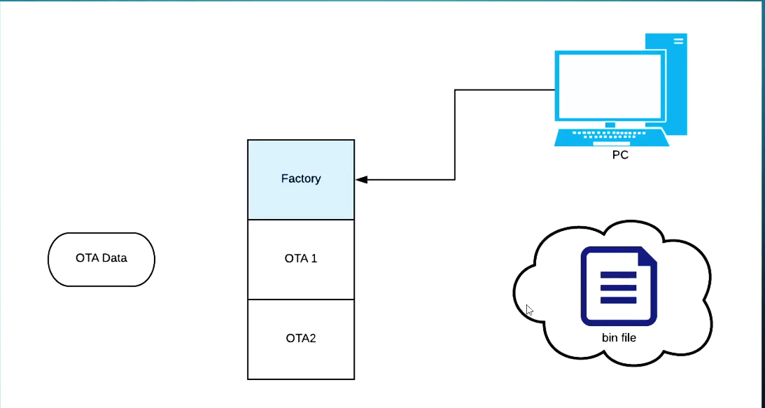
OTA – OVER THE AIR
OTA allows us to remotely flash our ESP32.
REQUIREMENTS:
The binary file that we want to flash onto our chip must be secured with https
We must have the certificate for that site embedded onto our chip
We must have atleast 2 OTA app (code) and an OTA data partition
A way to trigger the OTA process (timers, interrupts etc)
A stable Internet Connection

Slide 14
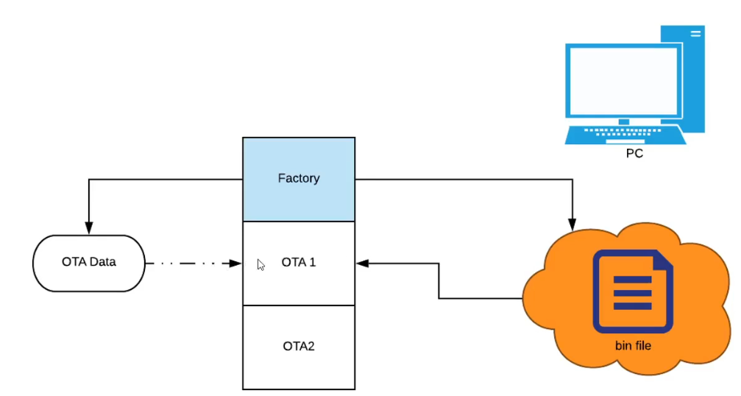
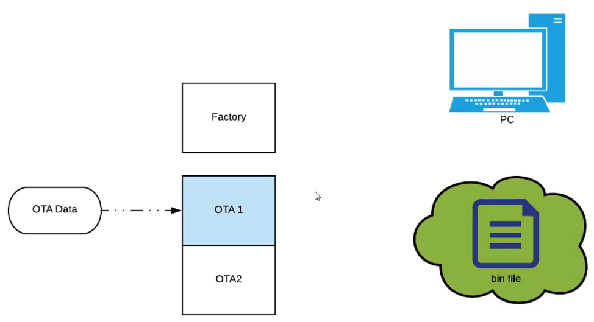
OTA UPDATES

Slide 15
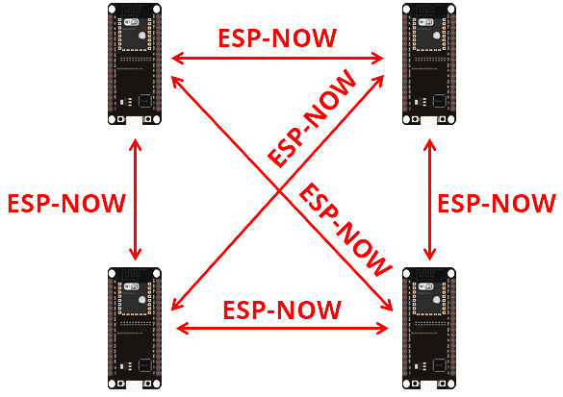
ESP - NOW
A wireless communication protocol for quick responses and low-power control.
Quick Response
No Internet Required
Low Power Consumption
Improved Range and Reception (~100m)
Pairing ( Max. 20 devices)
Payload is limited to 250 Bytes
One-way and two-way communication

Slide 16
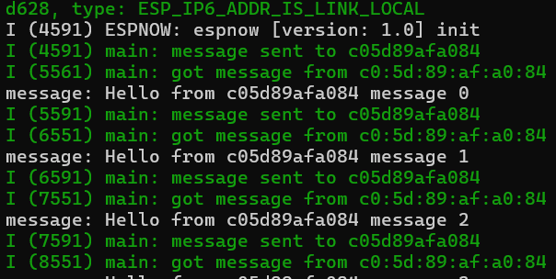
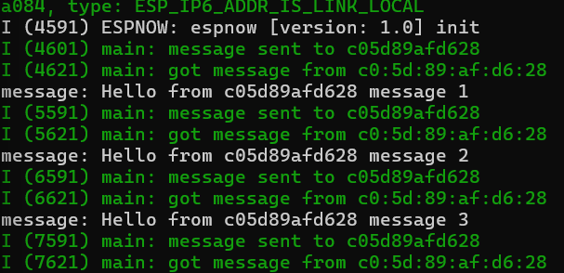
PEER-PEER HANDSHAKE
MAC of ESP1
MAC of ESP2

Slide 17
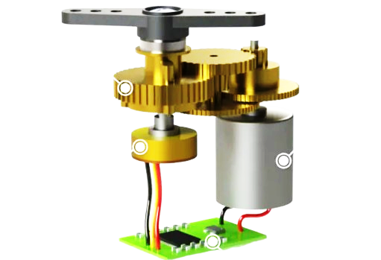
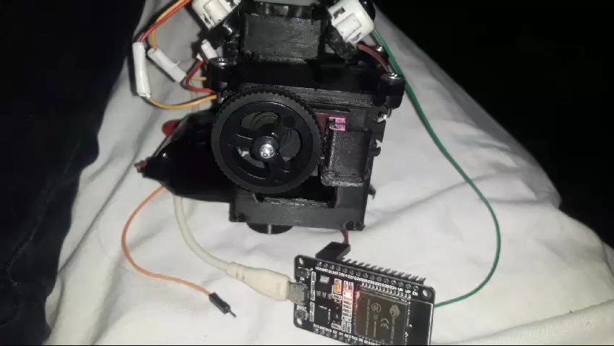
SERVO CONTROL
Control of both servos for forward/backward movement of the spherical robot
Opposite rotation of the servos for the robot’s change in orientation
Code based calibration for controlled robot movement for path following

Slide 18
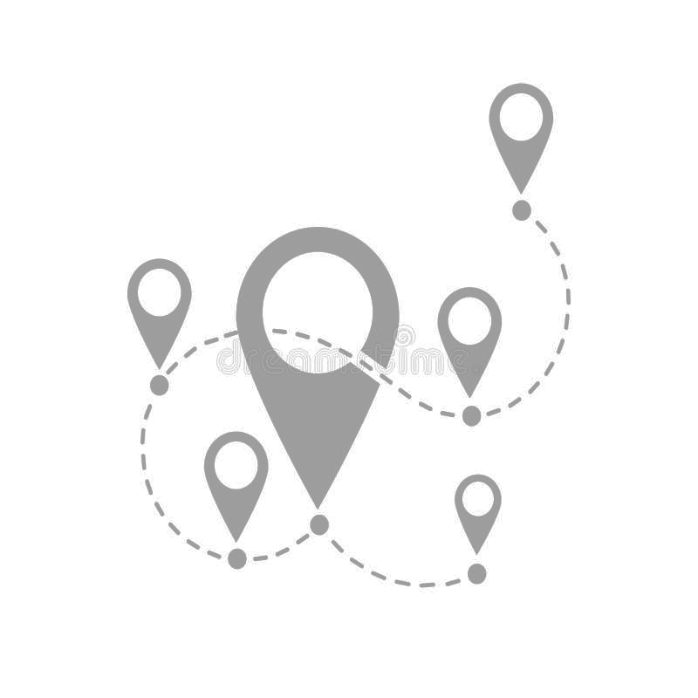
LOCALIZATION
Absolute Location and orientation of each module
Sensors for determining the location and orientation
Sensor Fusion
Challenges: Electro Magnetic Interference & closed environmnent due to metallic shell

Slide 19
RECONFIGURATION ALGORITHMS
Start
Receive User Command (Shape, Motion, or Task)
Localization & Mapping (Identify positions of all FreeBots)
Connectivity Check (Ensure communication between modules)
Path Planning & Movement (Decide movement strategy for reconfiguration)
Reconfigure Modules (Execute movement to form desired shape)
Verify Formation (Check if the configuration is correct)
Confirm & Execute Task (Perform the required function)
End

Slide 20



Slide 21


